Slide 1
Tucson Rapid Transit
Mayor and Council – January 23, 2024

Slide 2


Tucson Norte-Sur vs. Tucson Rapid Transit
Tucson Norte Sur (plan): | Tucson Rapid Transit (project):
the land-use planning and policy development along the transit corridors focused on affordable housing, multimodal connectivity, cultural preservation, and equitable policy development. | the identification and implementation of a specific bus rapid transit corridor, stations, and transit technology.

Slide 3
Why Bus Rapid Transit?
Bus Rapid Transit (BRT) can be planned, designed, and implemented at a much lower cost than other high-capacity transit.
Provides mobility solutions and addresses capacity issues generated by Tucson’s growing population.
Improve transit reliability in the study area.
Contribute to the advancement of a more equitable transit system by serving transportation disadvantaged and high transit propensity communities.
Notes:
Why are we doing this?
Bus rapid transit, or BRT, provides a more cost-efficient and enhanced transit experience compared to local transit services currently offered. BRT can be planned, designed, and implemented at a much lower cost than other high-capacity transit services, such as rail or streetcar, while still offering an improved rider experience through enhanced stations, dedicated lanes, transit signal priority, and high rider capacity.

Slide 4
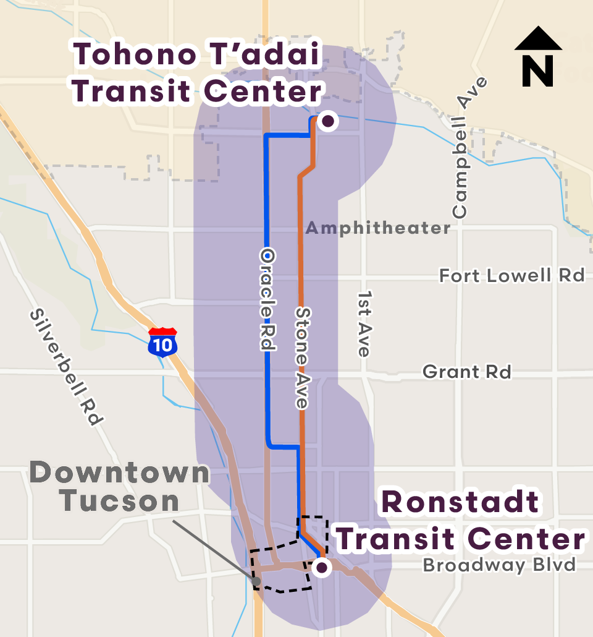
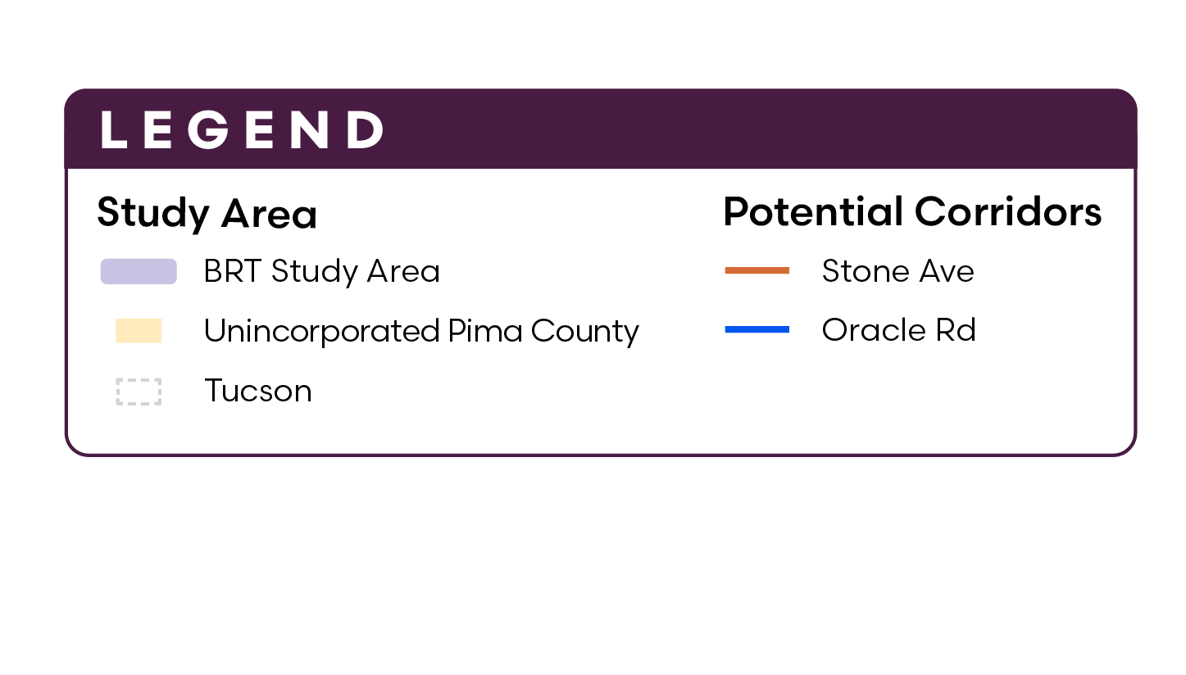
BRT Overview
Two alignment options:
Oracle Road corridor
Stone Avenue corridor
Notes:
Overview
Starts at Tohono T’adai Transit Center
Ends at Ronstadt Transit Center
Two alignment options:
Stone Avenue corridor
Oracle Road/State Route 77 corridor
Now let’s dive into Tucson Rapid Transit – North Segment! As mentioned, the project includes two segments, but the north segment is the primary topic of today’s discussion. The north segment is exploring BRT on either Oracle Road or Stone Avenue. Both options would connect Tohono T’adai Transit Center and the Tucson Mall to the Ronstadt Transit Center and Downtown Tucson.

Slide 5
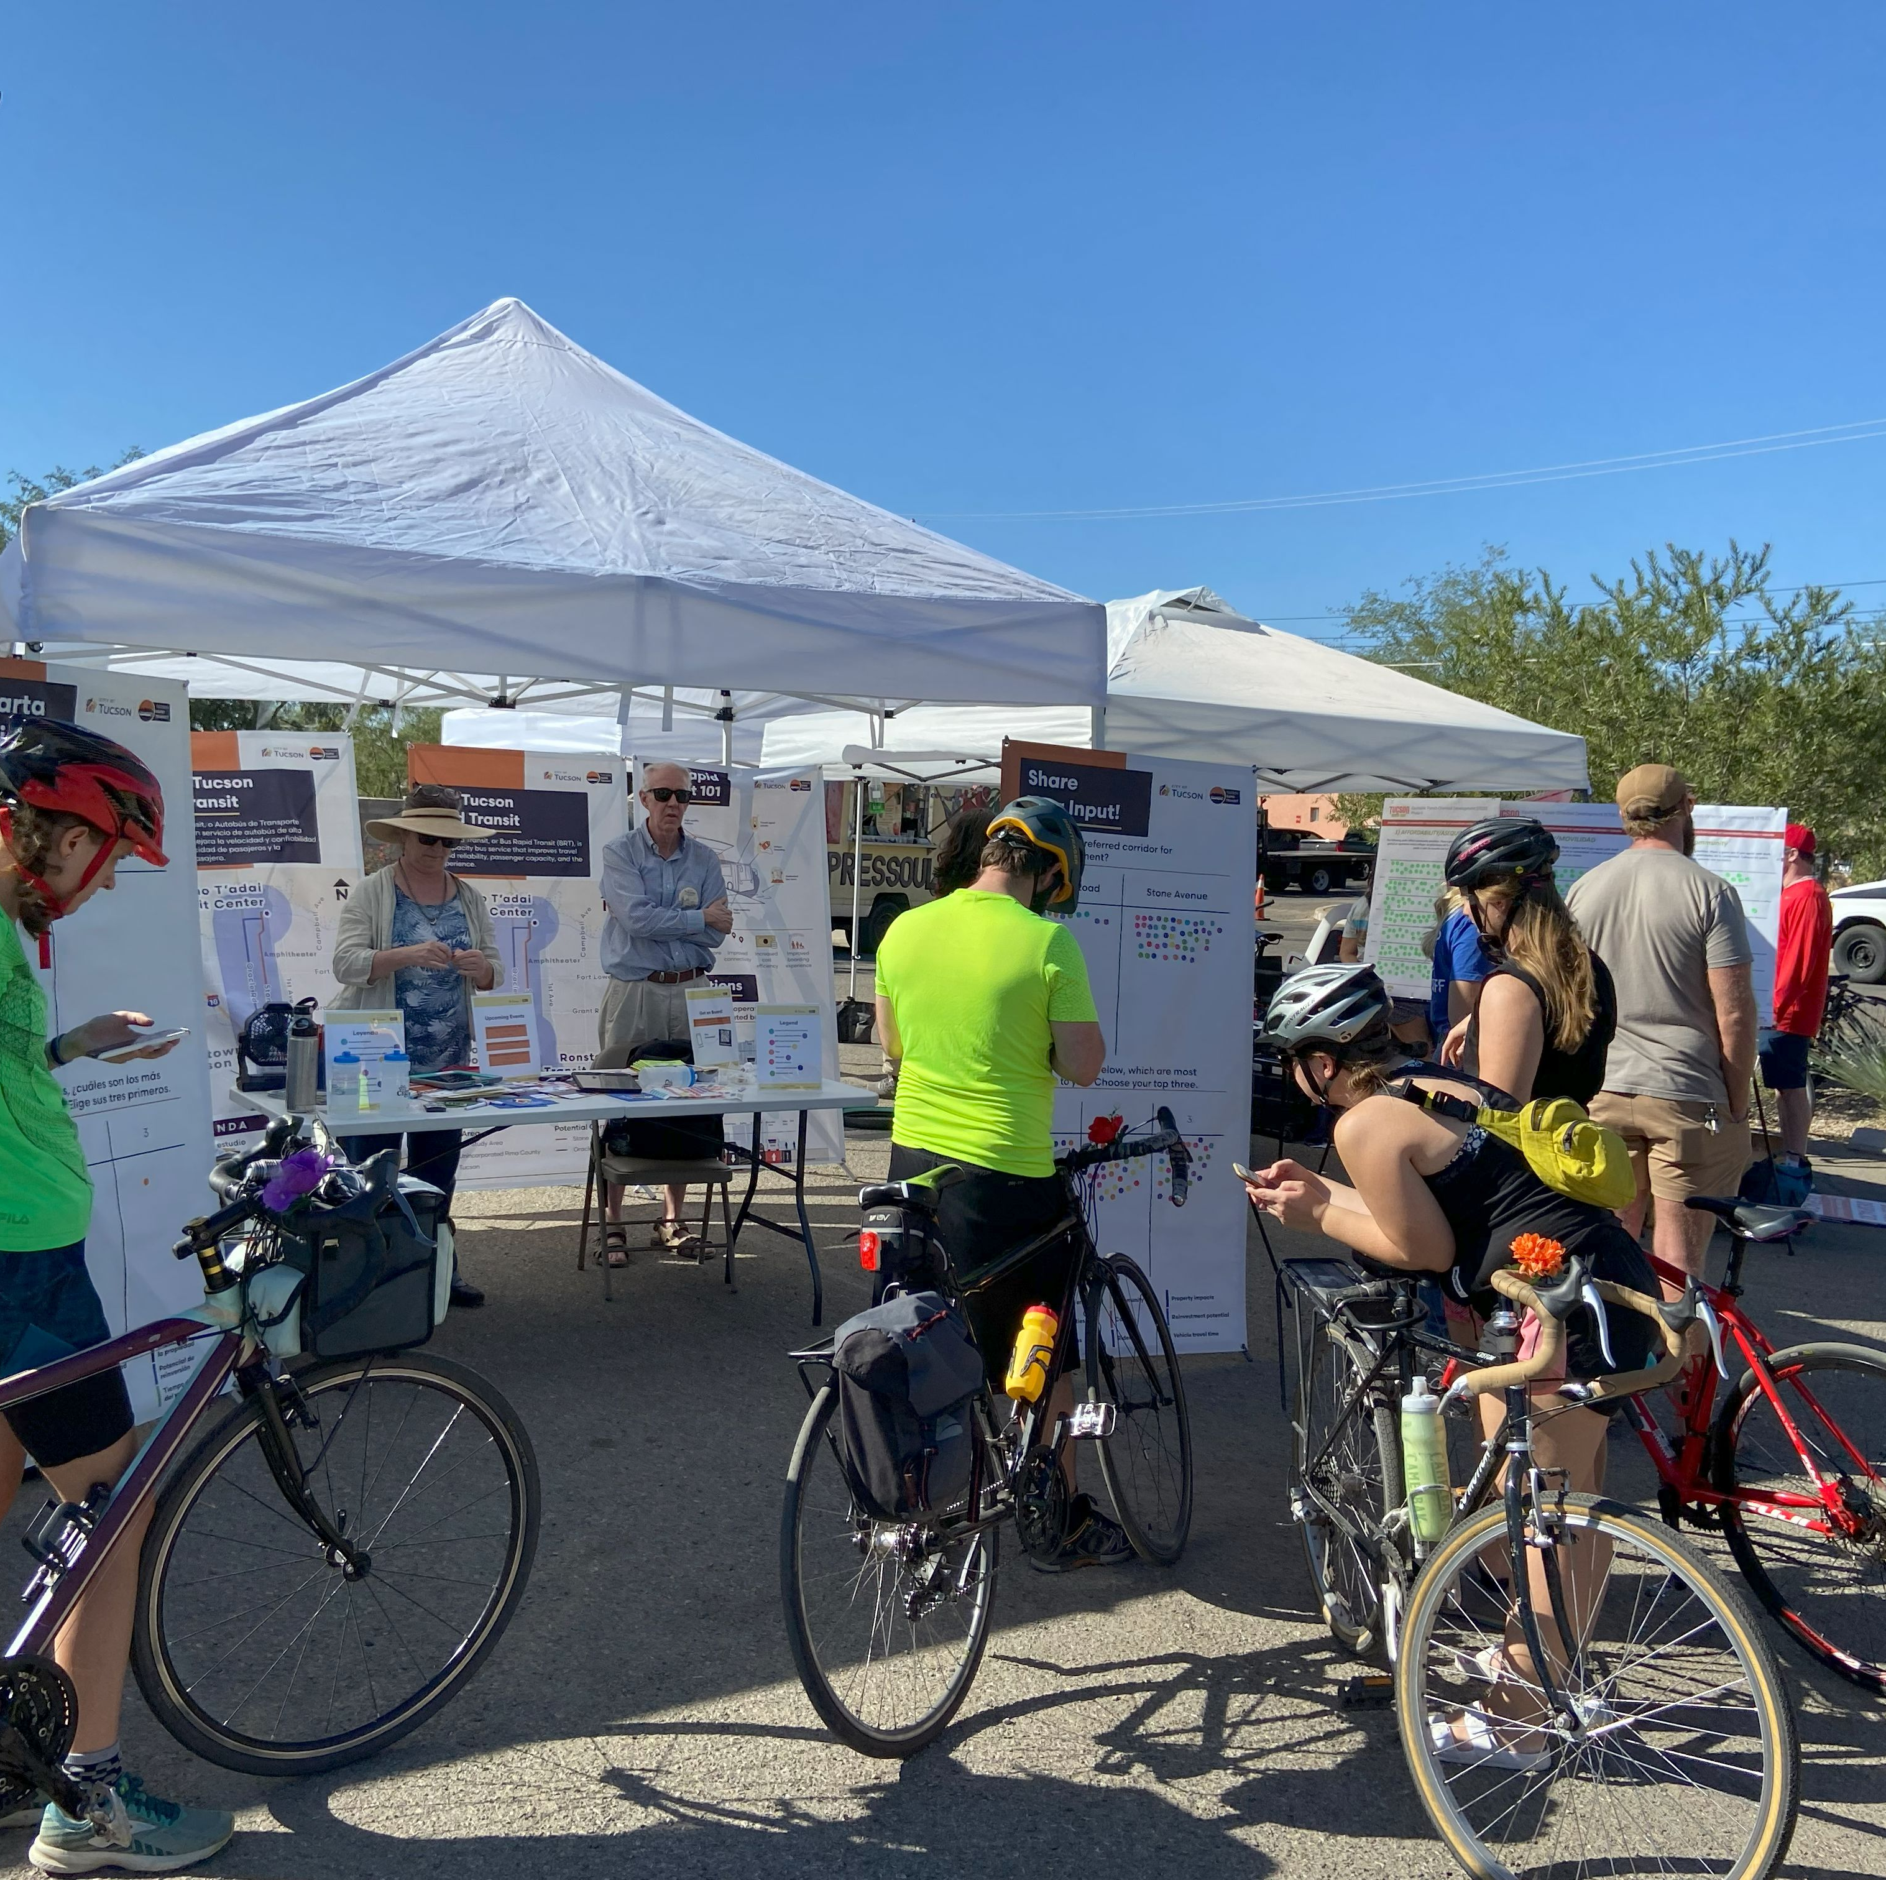
Outreach Events
Pop-up/Tabling Events (7)
Community Canvassing/One-on-One (5)
Community/Organization Meetings (6)
Public Meetings (3)
Feedback received through:
  Survey
  Interactive Banners
  General Comments
Outreach period:
  Oct 29 – Dec 8, 2023

Slide 6
Survey Findings – Which Corridor Do you Prefer?
Banners
Oracle:
35 votes
Stone:
61 votes
General Comments
(Public, Community Groups, and Committees)
Oracle:
3 votes
Includes the Tucson-Pima County Historical Commission’s preference for Oracle Rd.
Stone:
17 votes
Includes the Tucson Transit Advisory Committee preference for Stone Ave.
No preference or not provided: 48
Survey
(746 responses)

Slide 7
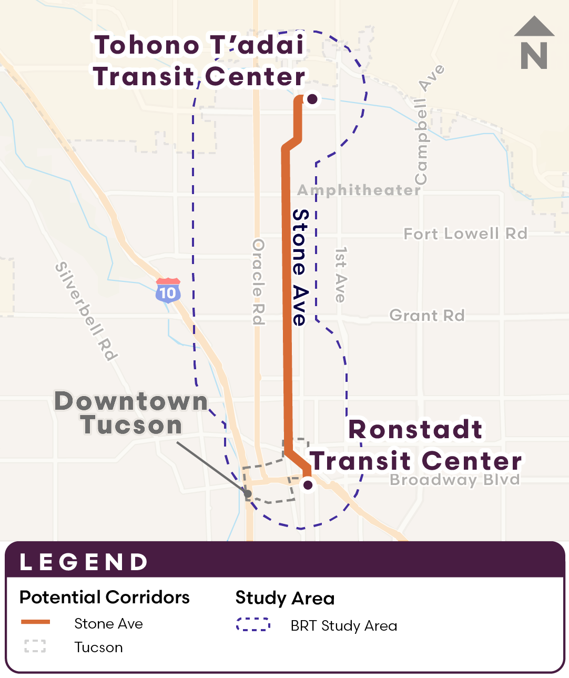
Community Engagement Results
Most Preferred Corridor:
Stone Avenue
Based on community input through surveys, interactive banners, general comments and our canvassing efforts, Stone Avenue is the preferred corridor for Tucson’s first BRT system.

Slide 8
Technical Analysis Findings
Higher Performing Corridor:
Stone Avenue
Greater travel time savings (15-20% more)
More direct connection to destinations
More transformative for multimodal safety
Existing route performance significant
Lower traffic volumes
  Potentially meets Tucson Road Diet Guidelines (in draft)
Higher reinvestment potential*
*based on vacant parcels

Slide 9
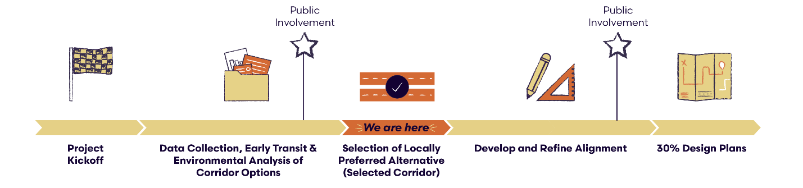
Next Steps
Staff Recommendation:
Mayor and Council endorse Stone Avenue as the Locally Preferred Alternative (LPA) for the north segment of Tucson Rapid Transit.

